Slide 1
SEO (Search Engine Optimization)

Slide 2
WHAT IS SEO?
It is a set of rules that can be followed by website (or blog) owners to optimize their websites for search engines and thus improve their search engine rankings.

Slide 3
SEO is essential because:
The majority of search engines users are more likely to click on one of the top 5 suggestions in the results pages (SERPS), so to take advantage of this and gain visitors to your web site or customers to your online store you need to in the top positions.
Users trust search engines and having a presence in the top positions for the keywords the user is searching, increases the web site’s trust.
SEO is good for the social promotion of your web site. People who find your web site by searching Google or Yahoo are more likely to promote it on Facebook, Twitter, Google+ or other social media channels.
SEO is important for the smooth running of a big web site. Web sites with more than one author can benefit from SEO in a direct and indirect way
SEO can put you ahead of the competition. If two web sites are selling the same thing, the search engine optimized web site is more likely to have more customers and make more sales.

Slide 4

Examples of search engine:

Slide 5
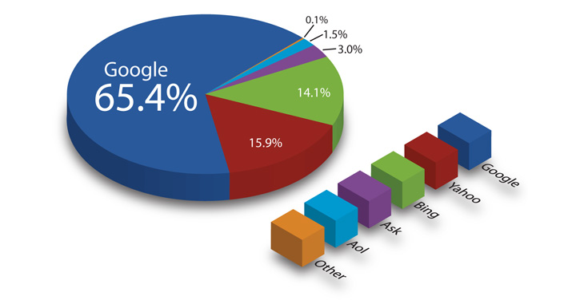
Search engine statistics:

Slide 6
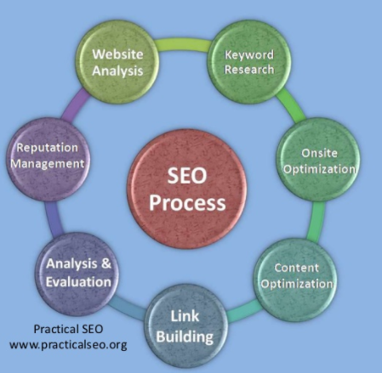
SEO Process:

Slide 7
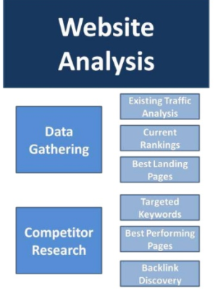
Website Analysis:

Slide 8
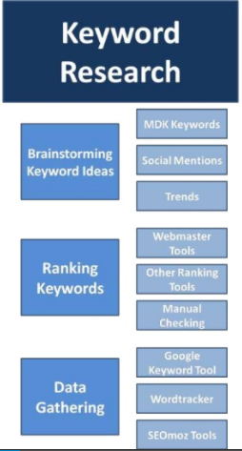
Keyword Research:

Slide 9
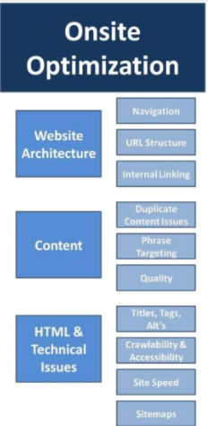
Onsite Optimization:

Slide 10
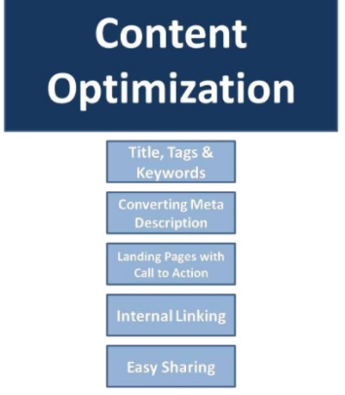
Content Optimization:

Slide 11
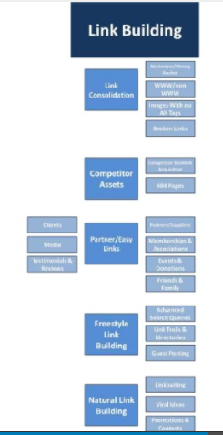
Link Building:

